Slide 1



Assignment 1 Power BI Sample
By James Lin (z5117057)
View in Power BI
Last data refresh:
3/8/2019 2:25:57 AM AUS Eastern Standard Time
Downloaded at:
3/8/2019 10:55:25 AM AUS Eastern Standard Time

Slide 2
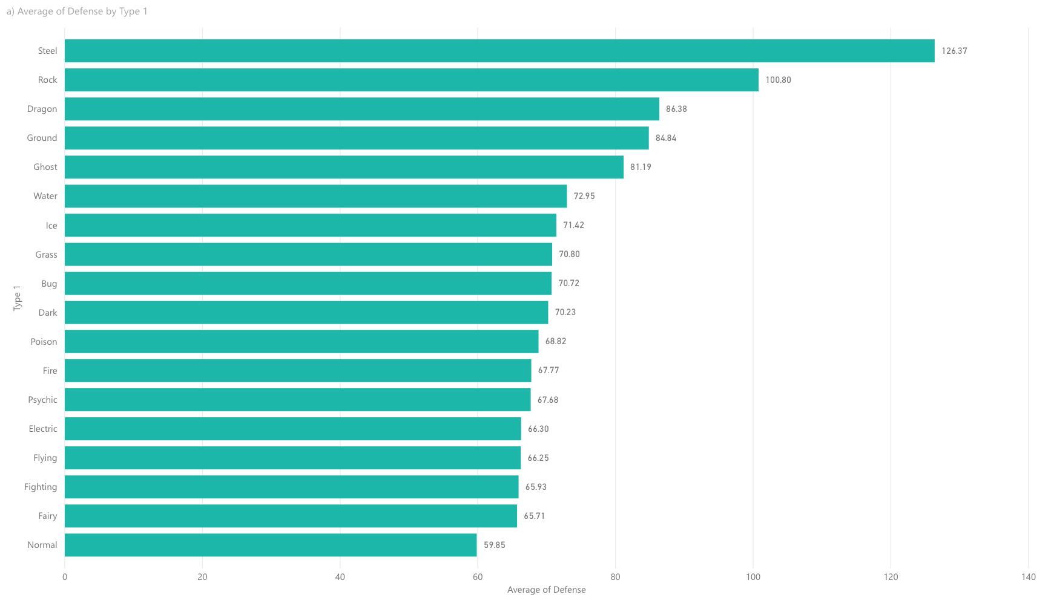

Slide 3
a)
In the bar plot a) Average of Defense by Type 1, it is evident that Pokemon with Type 1 steel have the highest average defense (at 126.37 units), while Pokemon of Type 1 Normal have the lowest average defense (at 59.85 units). These insights would be useful to my goal because ______.

Slide 4
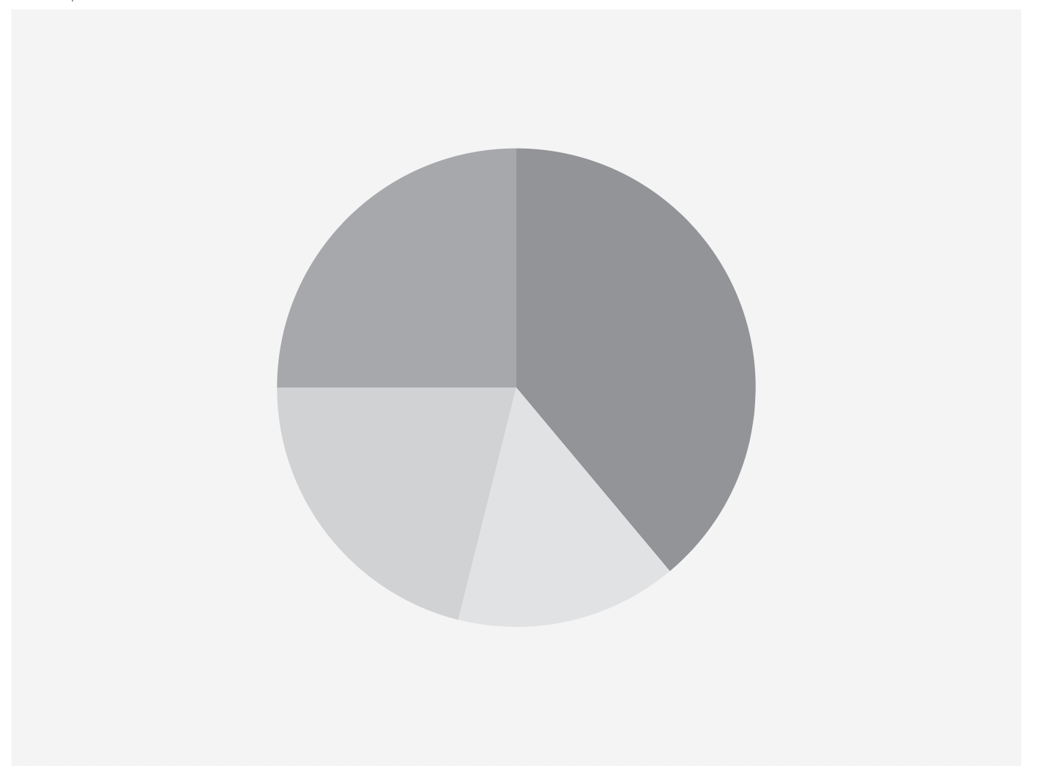

Slide 5
b)
Write something insightful about the graph in slide 4

Slide 6


Slide 7
c)
Write something insightful about the graph in slide 6

Slide 8


Slide 9
d)
Write something insightful about the graph in slide 8

Slide 10
